Slide 1
ECE 884 Deep Learning
Lecture 13-14: Convolutional Neural Networks
03/09,11/2021

Slide 2
Review of last lecture
Deep Neural Network Training Pipeline
Data preprocessing
Regularization for Neural Networks
Learning Rate Schedules

Slide 3
Today’s lecture
Convolutional Neural Network (ConvNet)
Notes:
To add:
Weight initialization
Batch normalization

Slide 4

Problem: So far our classifiers don’t respect the spatial structure of images
Stretch pixels into column
56
231
24
2
56 | 231
24 | 2
Input image (2, 2)
(4,1)

Slide 5
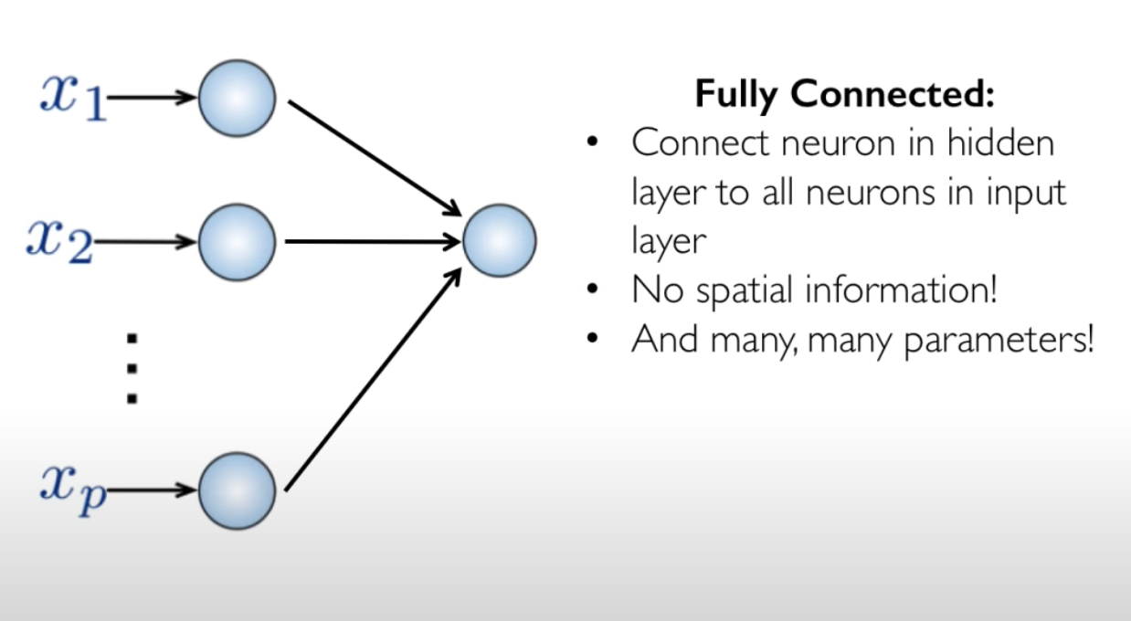
Problem: So far our classifiers don’t respect the spatial structure of images
56
231
24
2
(4,1)

Slide 6
Problem: So far our classifiers don’t respect the spatial structure of images
Stretch pixels into column
56
231
24
2
56 | 231
24 | 2
Input image (2, 2)
(4,1)
Solution: Define new computational nodes that operate on images!

Slide 7
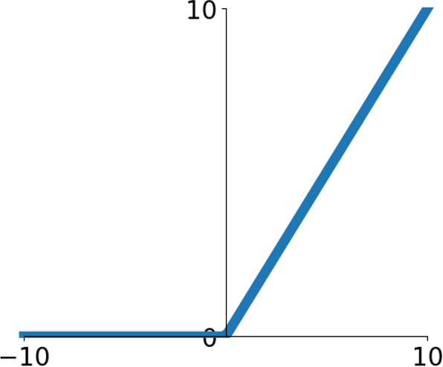
Components of a Fully-Connected Network
Fully-Connected Layers Activation Function
x
h
s

Slide 8
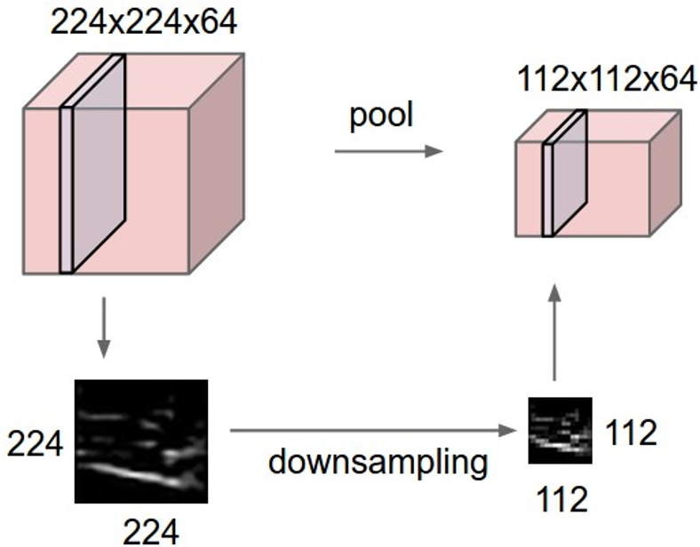

Components of a Convolutional Network
Fully-Connected Layers Activation Function
x
h
s
Convolution Layers
Pooling Layers
Batch Normalization
Layers

Slide 9
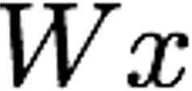

Fully-Connected Layer
32x32x3 image -> stretch to 3072 x 1
Input
Output
1
1
10 x 3072
weights
3072
10

Slide 10
Fully-Connected Layer
32x32x3 image -> stretch to 3072 x 1
Input
Output
1
1
10 x 3072
weights
3072
10
1 number:
the result of taking a dot product between a row of W and the input (a 3072- dimensional dot product)

Slide 11
Convolution Layer
3x32x32 image: preserve spatial structure
32 height
32
width
3
depth / channels

Slide 12
Convolution Layer
3x32x32 image
3x5x5 filter
Convolve the filter with the image
i.e. “slide over the image spatially, computing dot products”
32 height
32
width
3
depth / channels

Slide 13
Convolution Layer
Filters always extend the full depth of the input volume
3x32x32 image
3x5x5 filter
Convolve the filter with the image
i.e. “slide over the image spatially, computing dot products”
32 height
32
width
3
depth / channels

Slide 14
Convolution Layer
3x32x32 image
3x5x5 filter
1 number:
the result of taking a dot product between the filter and a small 3x5x5 chunk of the image
(i.e. 3*5*5 = 75-dimensional dot product + bias)
𝑤!𝑥 + 𝑏
32
32
3

Slide 15
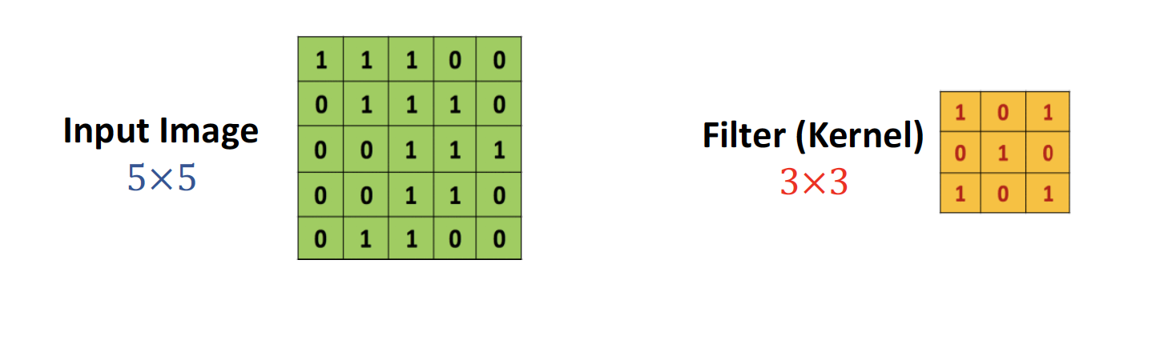
2D Convolution

Slide 16
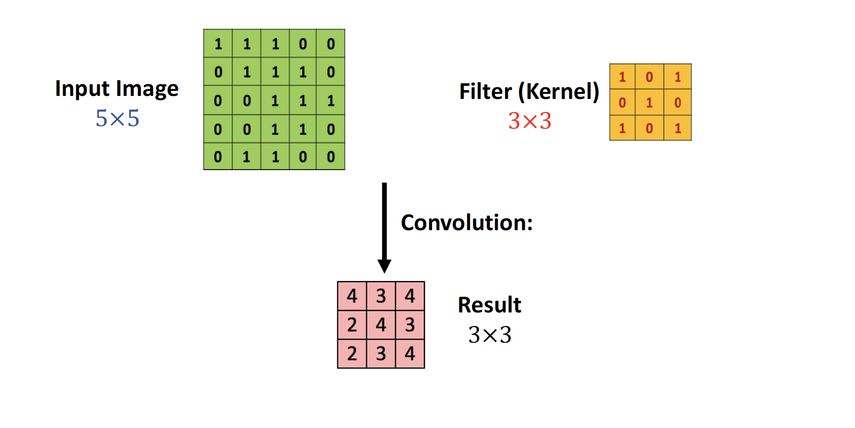
2D Convolution

Slide 17
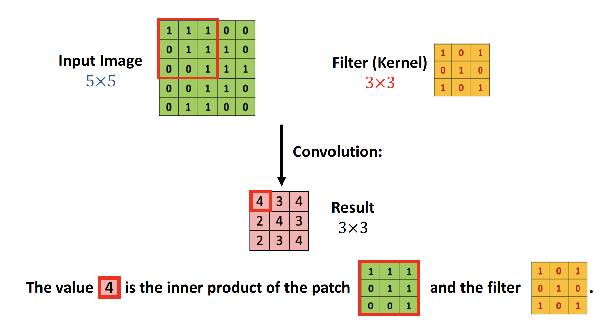
2D Convolution

Slide 18
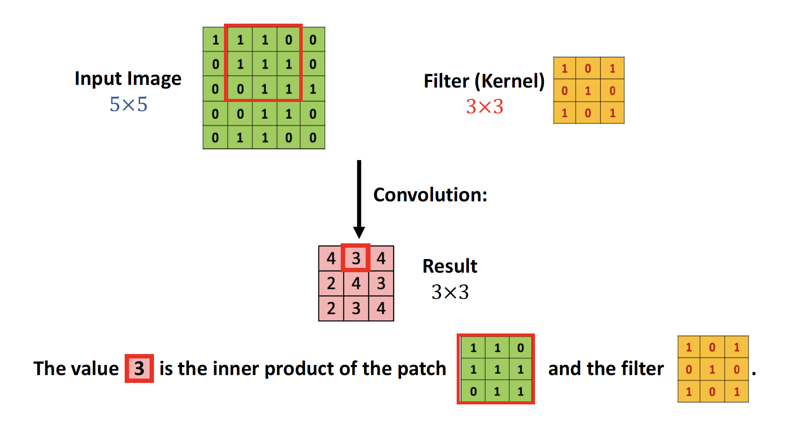
2D Convolution

Slide 19
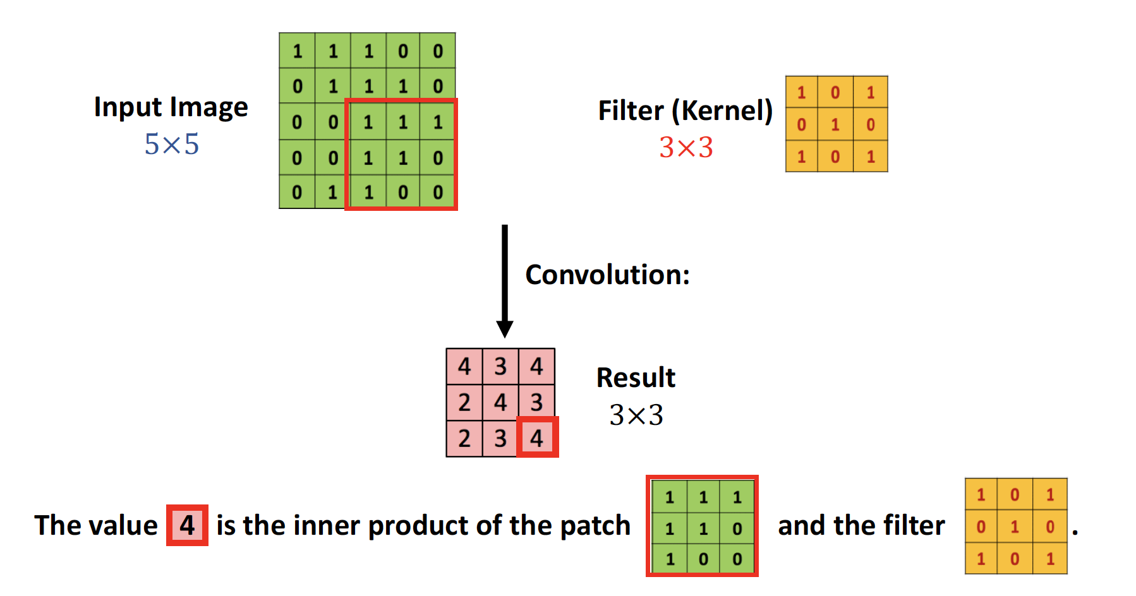
2D Convolution

Slide 20
Convolution Layer
1x28x28
activation map
3x32x32 image
3x5x5 filter
28
convolve (slide) over all spatial locations
32
28
32
1
3

Slide 21
Convolution Layer
two 1x28x28 activation map
3x32x32 image
Consider repeating with a second (green) filter:
3x5x5 filter
28
convolve (slide) over all spatial locations
32
28
32
1 1
3

Slide 22
Convolution Layer
6 activation maps, each 1x28x28
3x32x32 image
Consider 6 filters, each 3x5x5
Convolution Layer
32
32
6x3x5x5 filters
Stack activations to get a 6x28x28 output image!
3

Slide 23
Convolution Layer
6 activation maps, each 1x28x28
3x32x32 image Also 6-dim bias vector:
Convolution Layer
32
32
6x3x5x5 filters
Stack activations to get a 6x28x28 output image!
3

Slide 24
Stacking Convolutions
….
Conv
Conv
Conv

Slide 25
Stacking Convolutions
Q: What happens if we stack two convolution layers?
….
Conv
Conv
Conv

Slide 26
Stacking Convolutions
Q: What happens if we stack two convolution layers?
A: We get another convolution!
….
Conv
Conv
Conv
Convolution is a linear operation!

Slide 27
Stacking Convolutions
….
Conv
ReLU
Conv
ReLU
Conv
ReLU

Slide 28
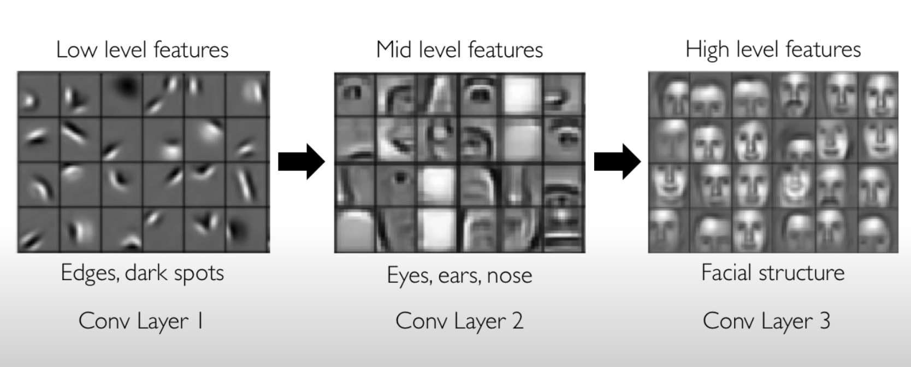
What do convolutional filters learn?

Slide 29
A closer look at spatial dimensions
Input: 7x7 Filter: 3x3
7
7

Slide 30
A closer look at spatial dimensions
Input: 7x7 Filter: 3x3
7
7

Slide 31
A closer look at spatial dimensions
Input: 7x7 Filter: 3x3
7
7

Slide 32
A closer look at spatial dimensions
Input: 7x7 Filter: 3x3
7
7

Slide 33
A closer look at spatial dimensions
Input: 7x7 Filter: 3x3 Output: 5x5
7
7

Slide 34
A closer look at spatial dimensions
Input: 7x7 Filter: 3x3 Output: 5x5
In general: Input: W
Problem: Feature maps “shrink” with each layer!
7
Filter: K
Output: W – K + 1
7

Slide 35
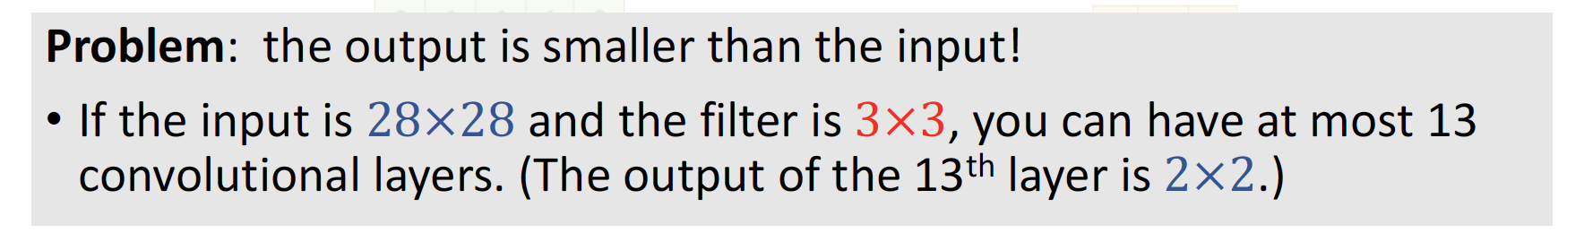
A closer look at spatial dimensions
Input: 7x7 Filter: 3x3 Output: 5x5
In general: Input: W
Problem: Feature maps “shrink” with each layer!
7
Filter: K
Output: W – K + 1
7

Slide 36
Zero Padding
0 | 0 | 0 | 0 | 0 | 0 | 0 | 0 | 0
0 |  |  |  |  |  |  |  | 0
0 |  |  |  |  |  |  |  | 0
0 |  |  |  |  |  |  |  | 0
0 |  |  |  |  |  |  |  | 0
0 |  |  |  |  |  |  |  | 0
0 |  |  |  |  |  |  |  | 0
0 |  |  |  |  |  |  |  | 0
0 | 0 | 0 | 0 | 0 | 0 | 0 | 0 | 0
Input: 7x7 Filter: 3x3 Output: 5x5
In general: Input: W
Problem: Feature maps “shrink” with each layer!
Filter: K
Output: W – K + 1
Solution: padding
Add zeros around the input

Slide 37
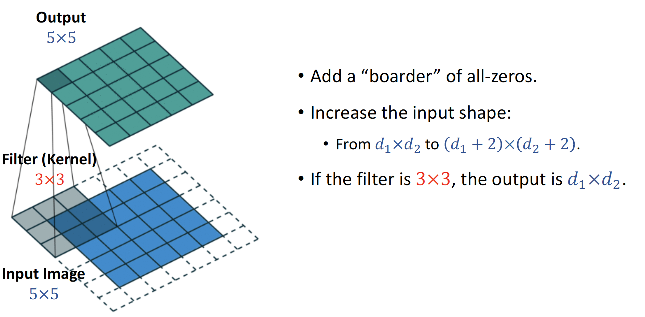
Zero Padding

Slide 38
Zero Padding
0 | 0 | 0 | 0 | 0 | 0 | 0 | 0 | 0
0 |  |  |  |  |  |  |  | 0
0 |  |  |  |  |  |  |  | 0
0 |  |  |  |  |  |  |  | 0
0 |  |  |  |  |  |  |  | 0
0 |  |  |  |  |  |  |  | 0
0 |  |  |  |  |  |  |  | 0
0 |  |  |  |  |  |  |  | 0
0 | 0 | 0 | 0 | 0 | 0 | 0 | 0 | 0
Input: 7x7 Filter: 3x3 Output: 5x5
In general: Input: W Filter: K Padding: P
Very common:
Set P = (K – 1) / 2 to make output have same size as input!
Output: W – K + 1 + 2P

Slide 39
Receptive Fields
For convolution with kernel size K, each element in the output depends on a K x K l o c a l receptive field in the input
Input
Output

Slide 40
Receptive Fields
Each successive convolution adds K – 1 to the receptive field size With L layers the receptive field size is 1 + L * (K – 1)
Input
Output
Be careful – ”receptive field in the input” vs “receptive field in the previous layer” Hopefully clear from context!

Slide 41
Receptive Fields
Each successive convolution adds K – 1 to the receptive field size With L layers the receptive field size is 1 + L * (K – 1)
Input
Problem: For large images we need many layers for each output to “see” the whole image image
Output

Slide 42
Receptive Fields
Each successive convolution adds K – 1 to the receptive field size With L layers the receptive field size is 1 + L * (K – 1)
Input
Problem: For large images we need many layers for each output to “see” the whole image image
Solution: Downsample inside the network
Output

Slide 43
Strided Convolution
Input: 7x7 Filter: 3x3 Stride: 2

Slide 44
Strided Convolution
Input: 7x7 Filter: 3x3 Stride: 2

Slide 45
Strided Convolution
Input: 7x7 Filter: 3x3 Stride: 2
Output: 3x3

Slide 46
Strided Convolution
Input: 7x7 Filter: 3x3 Stride: 2
In general: Input: W Filter: K Padding: P
Output: 3x3
Stride: S
Output: (W – K + 2P) / S + 1

Slide 47
1x1 Convolution
1x1 CONV
with 32 filters
(each filter has size 1x1x64, and performs a 64- dimensional dot product)
56
56
56
56
64
32

Slide 48
1x1 Convolution
1x1 CONV
with 32 filters
(each filter has size 1x1x64, and performs a 64- dimensional dot product)
Stacking 1x1 conv layers gives MLP operating on
56
56
56
56
64
32
each input position
Lin et al, “Network in Network”, ICLR 2014

Slide 49
Convolution Summary
Input: C_{in} x H x W
Hyperparameters:
Kernel size: K_{H} x K_{W}
Number filters: C_{out}
Padding: P
Stride: S

Slide 50
Components of a Convolutional Network
Pooling Layers

Slide 51
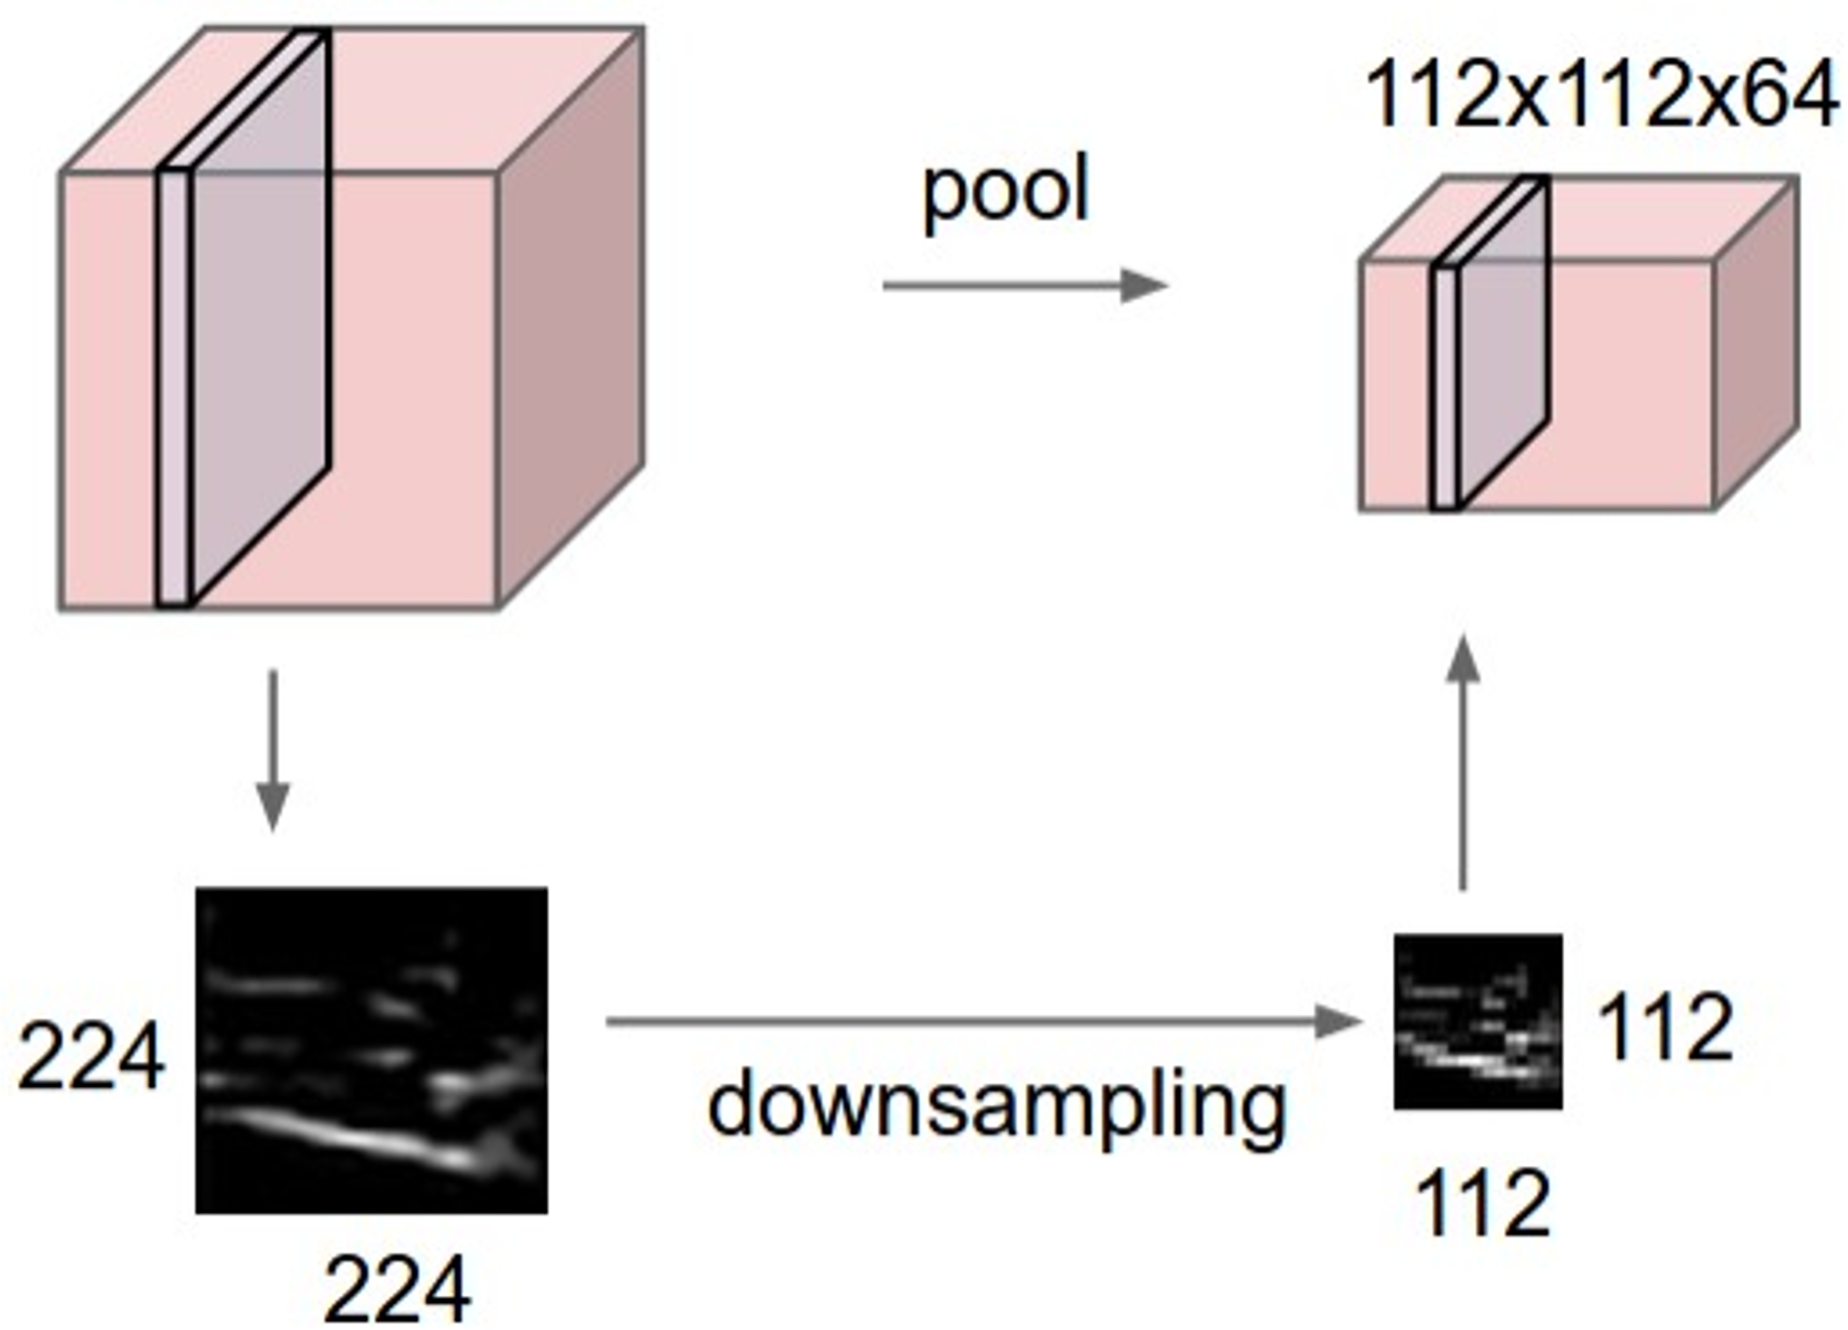
Pooling Layers: Another way to downsample
64 x 224 x 224
64 x 112 x 112
Hyperparameters: Kernel Size
Stride
Pooling function

Slide 52
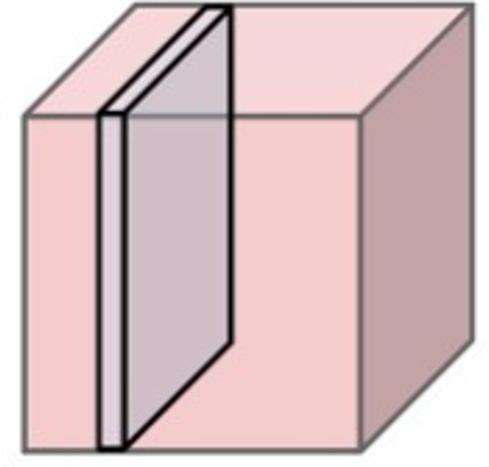
Max Pooling
64 x 224 x 224
Single depth slice
1 | 1 | 2 | 4
5 | 6 | 7 | 8
3 | 2 | 1 | 0
1 | 2 | 3 | 4
x
Max pooling with 2x2 kernel size and stride 2
6 | 8
3 | 4
Introduces invariance to small spatial shifts
y No learnable parameters!

Slide 53
Pooling Summary
Input: C x H x W
Hyperparameters:
Kernel size: K
Stride: S
Pooling function (max, avg)
Output: C x H’ x W’ where
- H’ = (H – K) / S + 1
- W’ = (W – K) / S + 1
Learnable parameters: None!

Slide 54
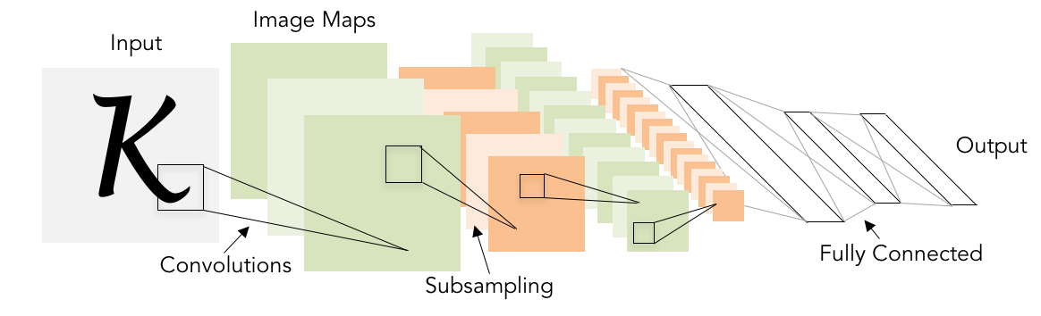
Convolutional Networks
Classic architecture: [Conv, ReLU, Pool] x N, flatten, [FC, ReLU] x N, FC
Example: LeNet-5
Lecun et al, “Gradient-based learning applied to document recognition”, 1998

Slide 55
Example: LeNet-5
Layer | Output Size | Weight Size
Input | 1 x 28 x 28
Conv (C_{out}=20, K=5, P=2, S=1) 20 x 28 x 28 20 x 1 x 5 x 5
ReLU 20 x 28 x 28
MaxPool(K=2, S=2) 20 x 14 x 14
Conv (C_{out}=50, K=5, P=2, S=1) 50 x 14 x 14 50 x 20 x 5 x 5
ReLU 50 x 14 x 14
MaxPool(K=2, S=2) 50 x 7 x 7
Flatten 2450
Linear (2450 -> 500) 500 2450 x 500
ReLU 500
Linear (500 -> 10) 10 500 x 10

Slide 56
Example: LeNet-5
Layer | Output Size | Weight Size
Input | 1 x 28 x 28
Conv (C_{out}=20, K=5, P=2, S=1) | 20 x 28 x 28 | 20 x 1 x 5 x 5
ReLU | 20 x 28 x 28
MaxPool(K=2, S=2) 20 x 14 x 14
Conv (C_{out}=50, K=5, P=2, S=1) 50 x 14 x 14 50 x 20 x 5 x 5
ReLU 50 x 14 x 14
MaxPool(K=2, S=2) 50 x 7 x 7
Flatten 2450
Linear (2450 -> 500) 500 2450 x 500
ReLU 500
Linear (500 -> 10) 10 500 x 10
Lecun et al, “Gradient-based learning applied to document recognition”, 1998

Slide 57
Example: LeNet-5
Layer | Output Size | Weight Size
Input | 1 x 28 x 28
Conv (C_{out}=20, K=5, P=2, S=1) | 20 x 28 x 28 | 20 x 1 x 5 x 5
ReLU | 20 x 28 x 28
MaxPool(K=2, S=2) | 20 x 14 x 14
Conv (C_{out}=50, K=5, P=2, S=1) 50 x 14 x 14 50 x 20 x 5 x 5
ReLU 50 x 14 x 14
MaxPool(K=2, S=2) 50 x 7 x 7
Flatten 2450
Linear (2450 -> 500) 500 2450 x 500
ReLU 500
Linear (500 -> 10) 10 500 x 10
Lecun et al, “Gradient-based learning applied to document recognition”, 1998

Slide 58
Example: LeNet-5
Layer | Output Size | Weight Size
Input | 1 x 28 x 28
Conv (C_{out}=20, K=5, P=2, S=1) | 20 x 28 x 28 | 20 x 1 x 5 x 5
ReLU | 20 x 28 x 28
MaxPool(K=2, S=2) | 20 x 14 x 14
Conv (C_{out}=50, K=5, P=2, S=1) | 50 x 14 x 14 | 50 x 20 x 5 x 5
ReLU | 50 x 14 x 14
MaxPool(K=2, S=2) 50 x 7 x 7
Flatten 2450
Linear (2450 -> 500) 500 2450 x 500
ReLU 500
Linear (500 -> 10) 10 500 x 10
Lecun et al, “Gradient-based learning applied to document recognition”, 1998

Slide 59
Example: LeNet-5
Layer | Output Size | Weight Size
Input | 1 x 28 x 28
Conv (C_{out}=20, K=5, P=2, S=1) | 20 x 28 x 28 | 20 x 1 x 5 x 5
ReLU | 20 x 28 x 28
MaxPool(K=2, S=2) | 20 x 14 x 14
Conv (C_{out}=50, K=5, P=2, S=1) | 50 x 14 x 14 | 50 x 20 x 5 x 5
ReLU | 50 x 14 x 14
MaxPool(K=2, S=2) | 50 x 7 x 7
Flatten 2450
Linear (2450 -> 500) 500 2450 x 500
ReLU 500
Linear (500 -> 10) 10 500 x 10
Lecun et al, “Gradient-based learning applied to document recognition”, 1998

Slide 60
Example: LeNet-5
Layer | Output Size | Weight Size
Input | 1 x 28 x 28
Conv (C_{out}=20, K=5, P=2, S=1) | 20 x 28 x 28 | 20 x 1 x 5 x 5
ReLU | 20 x 28 x 28
MaxPool(K=2, S=2) | 20 x 14 x 14
Conv (C_{out}=50, K=5, P=2, S=1) | 50 x 14 x 14 | 50 x 20 x 5 x 5
ReLU | 50 x 14 x 14
MaxPool(K=2, S=2) | 50 x 7 x 7
Flatten | 2450
Linear (2450 -> 500) 500 2450 x 500
ReLU 500
Linear (500 -> 10) 10 500 x 10
Lecun et al, “Gradient-based learning applied to document recognition”, 1998

Slide 61
Example: LeNet-5
Layer | Output Size | Weight Size
Input | 1 x 28 x 28
Conv (C_{out}=20, K=5, P=2, S=1) | 20 x 28 x 28 | 20 x 1 x 5 x 5
ReLU | 20 x 28 x 28
MaxPool(K=2, S=2) | 20 x 14 x 14
Conv (C_{out}=50, K=5, P=2, S=1) | 50 x 14 x 14 | 50 x 20 x 5 x 5
ReLU | 50 x 14 x 14
MaxPool(K=2, S=2) | 50 x 7 x 7
Flatten | 2450
Linear (2450 -> 500) | 500 | 2450 x 500
ReLU | 500
Linear (500 -> 10) 10 500 x 10
Lecun et al, “Gradient-based learning applied to document recognition”, 1998

Slide 62
Example: LeNet-5
Layer | Output Size | Weight Size
Input | 1 x 28 x 28
Conv (C_{out}=20, K=5, P=2, S=1) | 20 x 28 x 28 | 20 x 1 x 5 x 5
ReLU | 20 x 28 x 28
MaxPool(K=2, S=2) | 20 x 14 x 14
Conv (C_{out}=50, K=5, P=2, S=1) | 50 x 14 x 14 | 50 x 20 x 5 x 5
ReLU | 50 x 14 x 14
MaxPool(K=2, S=2) | 50 x 7 x 7
Flatten | 2450
Linear (2450 -> 500) | 500 | 2450 x 500
ReLU | 500
Linear (500 -> 10) | 10 | 500 x 10
Lecun et al, “Gradient-based learning applied to document recognition”, 1998

Slide 63
Example: LeNet-5
Layer | Output Size | Weight Size
Input | 1 x 28 x 28
Conv (C_{out}=20, K=5, P=2, S=1) | 20 x 28 x 28 | 20 x 1 x 5 x 5
ReLU | 20 x 28 x 28
MaxPool(K=2, S=2) | 20 x 14 x 14
Conv (C_{out}=50, K=5, P=2, S=1) | 50 x 14 x 14 | 50 x 20 x 5 x 5
ReLU | 50 x 14 x 14
MaxPool(K=2, S=2) | 50 x 7 x 7
Flatten | 2450
Linear (2450 -> 500) | 500 | 2450 x 500
ReLU | 500
Linear (500 -> 10) | 10 | 500 x 10
As we go through the network:
Spatial size decreases
(using pooling or strided conv)
Number of channels increases
(total “volume” is preserved!)
Lecun et al, “Gradient-based learning applied to document recognition”, 1998
Notes:
Q: why ReLU before MaxPool?

Slide 64
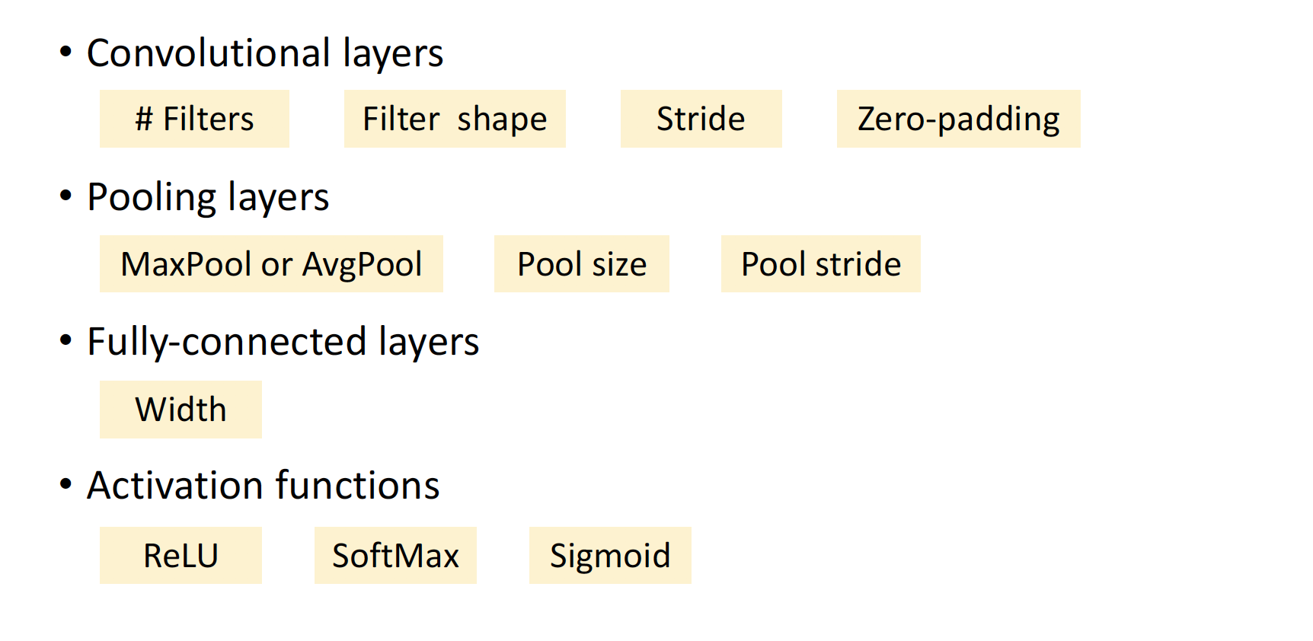
Hyperparameters for CNN

Slide 65
Batch Normalization

Slide 66
Batch Normalization: Standardization of Hidden Layers
Recall: we do normalization for the input of the DNN.
Idea: “Normalize” the outputs of a layer so they have zero mean and unit variance.
Why? Helps speed up the training.

Slide 67
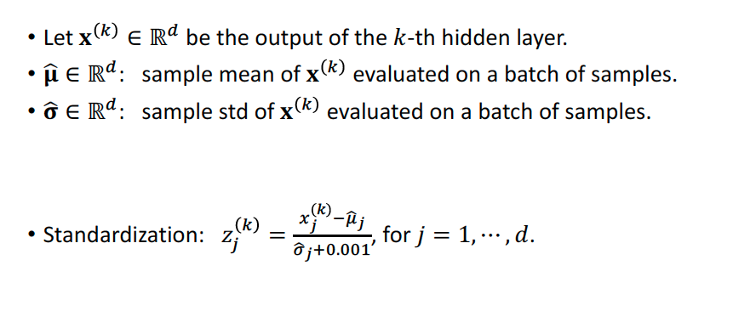
Batch Normalization: Standardization of Hidden Layers

Slide 68
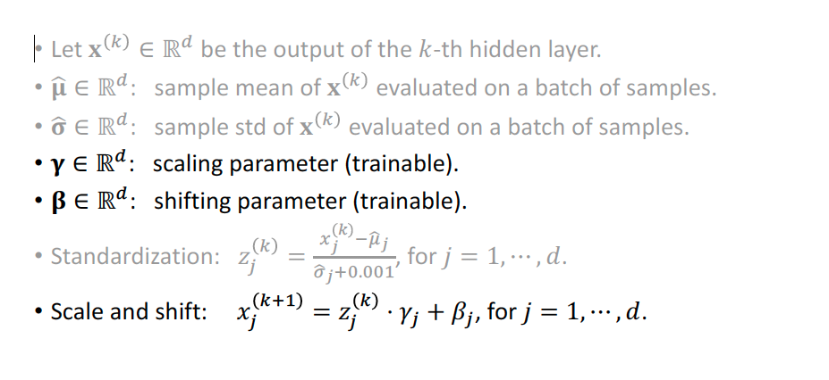
Batch Normalization: Standardization of Hidden Layers

Slide 69
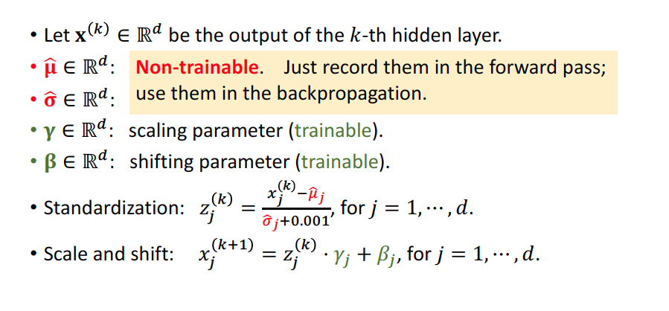
Batch Normalization: Standardization of Hidden Layers

Slide 70
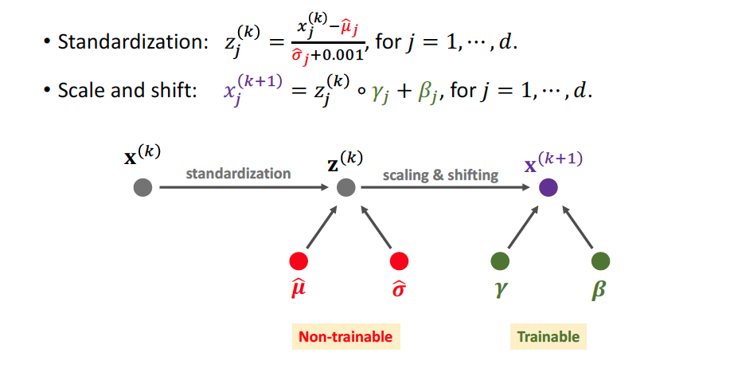
Batch Normalization: Standardization of Hidden Layers

Slide 71
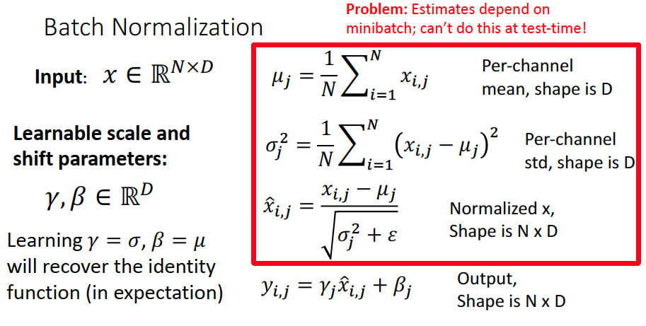

Slide 72
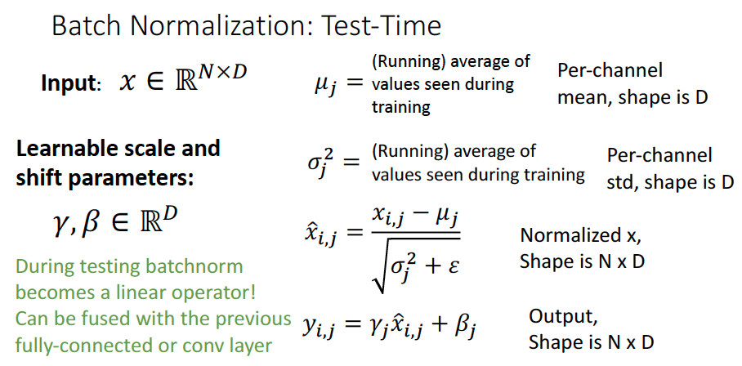

Slide 73
Batch Normalization
FC
Usually inserted after Fully Connected or Convolutional layers, and before nonlinearity.
BN
tanh
FC
BN
tanh

Slide 74
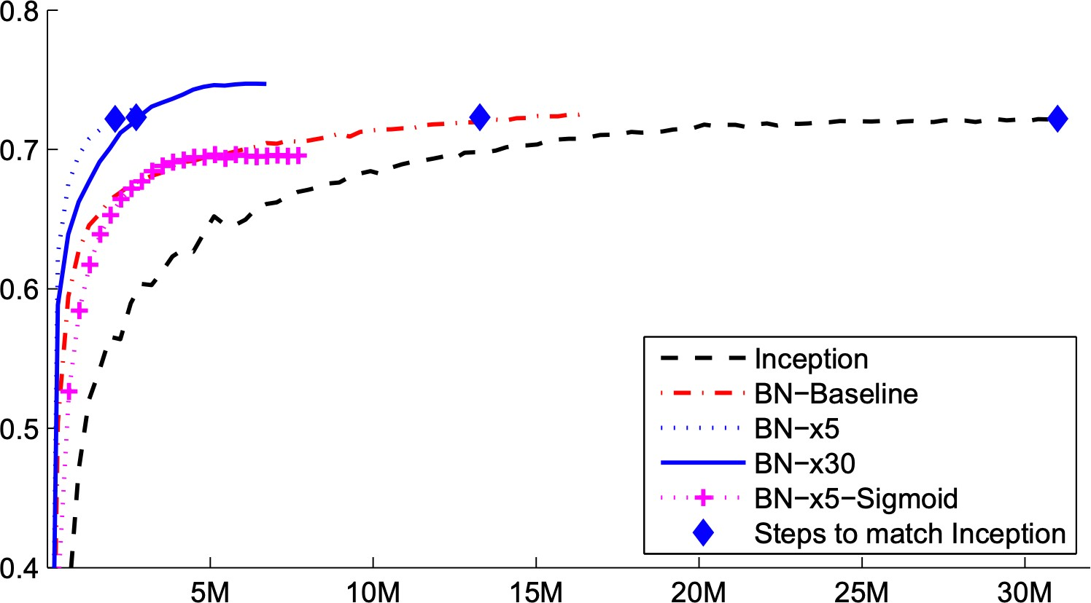
Batch Normalization
Makes deep networks much easier to train!
Allows higher learning rates, faster convergence
Networks become more robust to initialization
Acts as regularization during training
Zero overhead at test-time: can be fused with conv!
FC
BN
tanh
FC
BN
ImageNet accuracy
tanh
Training iterations

Slide 75
Any Question ?

